Slide 1
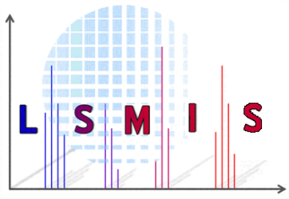

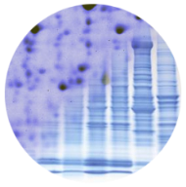

Complete sequence coverage in one injection followed by posttranslational modifications and major N-glycosylation characterization of monoclonal antibodies by sheathless CESI-MS/MS
R. Gahoual¹, J-M. Busnel², J. Chicher³, L. Kuhn³,
P. Hammann³, A. Beck⁴, Y.N. François¹, E. Leize-Wagner¹
¹Laboratory of Mass Spectrometry of Interactions and Systems, University of Strasbourg (CNRS-UDS UMR 7140)
²Beckman Coulter, Brea (CA, USA)
³IEsplanade Proteomic Facility, IBMC, University of Strasbourg (CNRS-UDS-UPR 9002)
⁴Centre d’immunologie Pierre Fabre (CIPF)
October 17th, 2013
EUPA – Saint-Malo

Slide 2
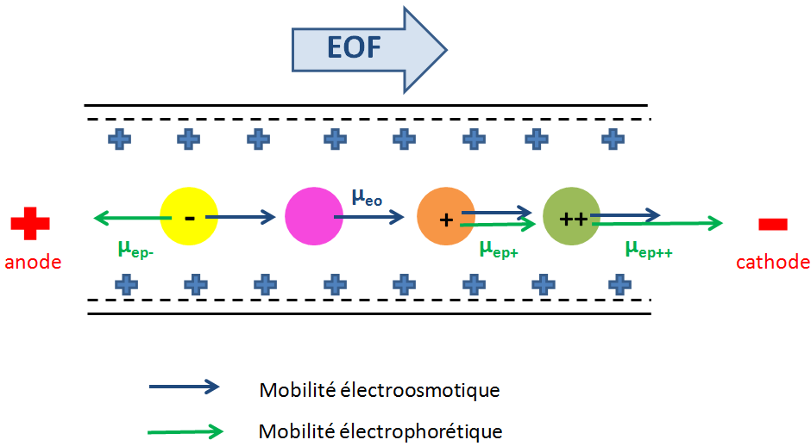
Separation in capillary electrophoresis
electroosmotic mobility
electrophoretic mobility
Analytes are separated depending on their charge and size
CE provides
fast separation
great efficiency
low sample consumption

Slide 3
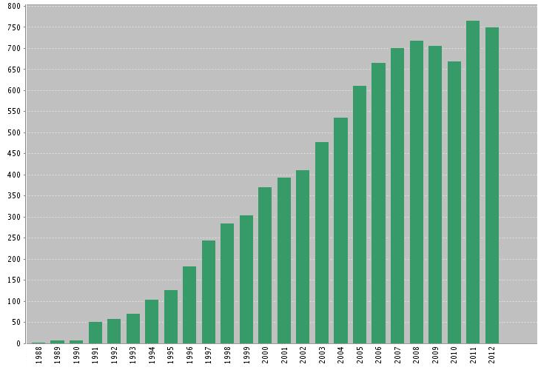
CE–MS Coupling
Number of publications
Web of scienceSM search using term “capillary electrophoresis and mass spectrometry”

Slide 4
CE-ESI-MS Coupling
Advantages of CE-MS
Great efficiency
Ultra-low flow rate
Selectivity
Sensitivity
Structural information
Drawbacks of CE-MS
Low sample volume (high concentration)
Compatibility of background electrolyte to MS
Difficulty to maintain electrical field

Slide 5
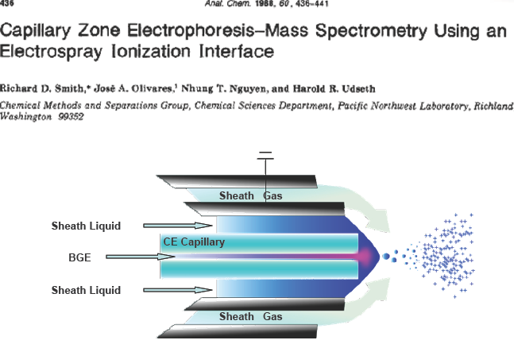
Addressing CE-MS Limitations
“sheath liquid” interface is the most common
Over 30 publications describing new interfaces
3 different categories (sheath liquid, junction liquid, sheathless)

Slide 6
Addressing CE-MS Limitations
CE is a miniaturized technique performing ultra-low flow rates
Decreasing the flow allows for increased sensitivity in the ESI-MS¹
“Sheathless”
CE-ESI-MS
¹Wilm, Mann International Journal of Mass Spectrometry 1994, 136, 167–180

Slide 7
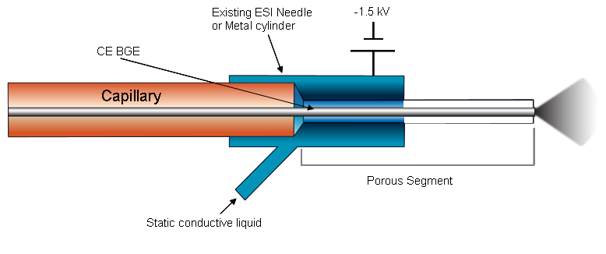
CESI Interface
30 µm ID separation capillary with outlet portion etched by HF, provides electrical contact
Originally developed by M. Moini at U. of Texas and further developed by Beckman Coulter Inc.

Slide 8
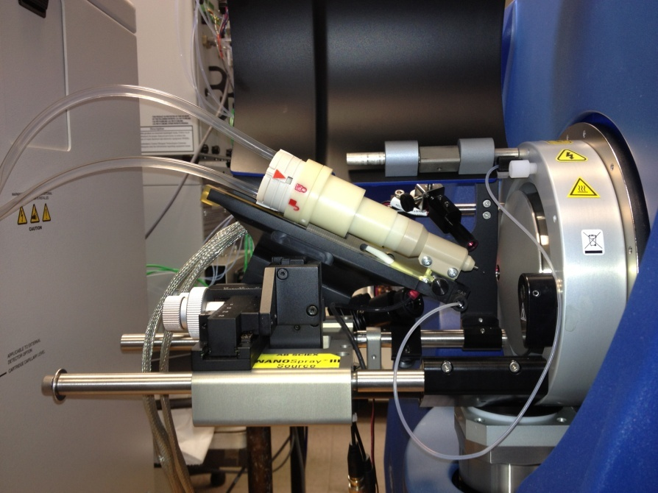
CESI Interface
No sheath liquid is necessary anymore to perform CE-ESI-MS
nano flow rates and increased sensitivity

Slide 9
What are the accessible flow rates?

Slide 10
CESI Interface Achievable Flow rates
CESI-MS infusion of intact protein sample
Conditions : Myoglobin 1 μM (in 10% acetic acid), Flow rates 3, 7 - 170 nL/min, Capillary voltage: -1400V, Investigated m/z : 848,94
Spray could be obtained using flow rate as low as 4 nL/min
Gahoual et al, Analytical and Bioanalytical Chemistry 2013, online available

Slide 11
Influence of the flow rate on sensitivity
Infusion of Myoglobin 250nM (in 20mM AceNH₄ pH 6,7)
Conditions : Flowrate 4 - 700 nL/min Capillary voltage : - 1400V, Investigated m/z : 2196
46 fold increase in sensitivity by decreasing the Flow rate
from 350 to 10 nL/min
Gahoual et al, Analytical and Bioanalytical Chemistry 2013, online available

Slide 12
Content
Introduction
Rapid and multi-level characterization of monoclonal antibody through CESI-MS workflow

Slide 13
Monoclonal Antibodies (mAbs)
Highly specific to the targeted antigen
Opening new pathways for treatments
Over 40 mAbs currently approved by FDA (15 in oncology)
Complex and heterogeneous protein
necessity of precise and high throughput characterization
challenge to analytical sciences

Slide 14
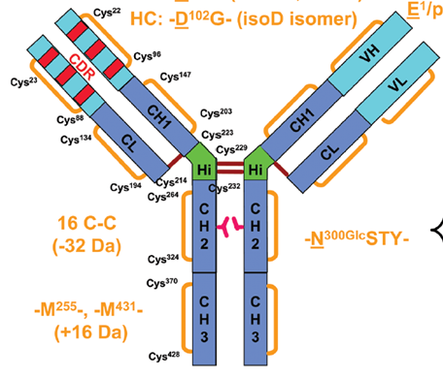
Trastuzumab (Herceptin)
IgG1
-N^{300Glc}STY-
Average mass: 148,057 Da (1,328 a.a.)
A. Beck et al., Anal. Chem. 2012, 84, 4637-4646

Slide 15
Bottom-up Approach
Protein enzymatic digestion
  Tryptic digestion (conventional in solution protocol)
Peptide separation and detection by NanoLC-MS/MS
  Eksigent nanoLC™ 2D plus system with cHiPLC® System
  AB SCIEX TripleTOF® 5600 System
Peptide identification using search algorithm
  Mascot algorithm

Slide 16
mAb sequence coverage
Trastuzumab peptide mapping using nanoLC-MS/MS
EVQLVESGGG LVQPGGSLRL SCAASGFNIK DTYIHWVRQA PGKGLEWVAR
IYPTNGYTRY ADSVKGRFTI SADTSKNTAY LQMNSLRAED TAVYYCSRWG
GDGFYAMDYW GQGTLVTVSS ASTKGPSVFP LAPSSKSTSG GTAALGCLVK
DYFPEPVTVS WNSGALTSGV HTFPAVLQSS GLYSLSSVVT VPSSSLGTQT
YICNVNHKPS NTKVDKKVEP KSCDKTHTCP PCPAPELLGG PSVFLFPPKP
KDTLMISRTP EVTCVVVDVS HEDPEVKFNW YVDGVEVHNA KTKPREEQYN
STYRVVSVLT VLHQDWLNGK EYKCKVSNKA LPAPIEKTIS KAKGQPREPQ
VYTLPPSREE MTKNQVSLTC LVKGFYPSDI AVEWESNGQP ENNYKTTPPV
LDSDGSFFLY SKLTVDKSRW QQGNVFSCSV MHEALHNHYT QKSLSLSPG
DIQMTQSPSS LSASVGDRVT ITCRASQDVN TAVAWYQQKP GKAPKLLIYS
ASFLYSGVPS RFSGSRSGTD FTLTISSLQP EDFATYYCQQ HYTTPPTFGQ
GTKVEIKRTV AAPSVFIFPP SDEQLKSGTA SVVCLLNNFY PREAKVQWKV
DNALQSGNSQ ESVTEQDSKD STYSLSSTLT LSKADYEKHK VYACEVTHQG
LSSPVTKSFN RGEC
74.6 %
95.4 %
Necessity to perform a different proteolytic digestion and to compile different injections to obtain full sequence coverage

Slide 17
CESI Workflow

Slide 18
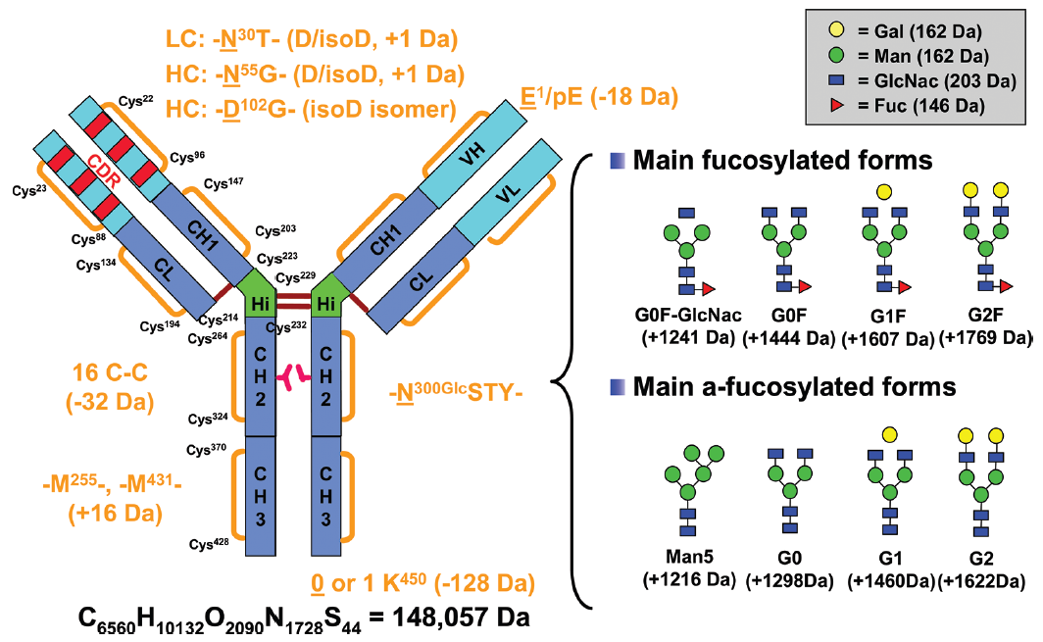
Trastuzumab (Herceptin)
LC : -N³⁰T – (D/isoD, +1 Da)
HC : -N⁵⁵T – (D/isoD, +1 Da)
HC : -N³⁸⁷T – (D/isoD, +1 Da)
Average mass: 148,057 Da (1,328 a.a.)
A. Beck et al., Anal. Chem. 2012, 84, 4637-4646

Slide 19
Bottom-up Approach
Protein enzymatic digestion
  Same Sample of trastruzumab (same protocol)
Peptide separation and detection by CESI-MS/MS
  AB SCIEX TripleTOF 5600 System
Sequence characterization by MS/MS peptide mapping
Research of glycosylation and posttranslational modifications

Slide 20
Trastuzumab MS/MS peptide mapping
Amino acid sequence characterization (trastuzumab)
EVQLVESGGG LVQPGGSLRL SCAASGFNIK DTYIHWVRQA PGKGLEWVAR
IYPTNGYTRY ADSVKGRFTI SADTSKNTAY LQMNSLRAED TAVYYCSRWG
GDGFYAMDYW GQGTLVTVSS ASTKGPSVFP LAPSSKSTSG GTAALGCLVK
DYFPEPVTVS WNSGALTSGV HTFPAVLQSS GLYSLSSVVT VPSSSLGTQT
YICNVNHKPS NTKVDKKVEP KSCDKTHTCP PCPAPELLGG PSVFLFPPKP
KDTLMISRTP EVTCVVVDVS HEDPEVKFNW YVDGVEVHNA KTKPREEQYN
STYRVVSVLT VLHQDWLNGK EYKCKVSNKA LPAPIEKTIS KAKGQPREPQ
VYTLPPSREE MTKNQVSLTC LVKGFYPSDI AVEWESNGQP ENNYKTTPPV
LDSDGSFFLY SKLTVDKSRW QQGNVFSCSV MHEALHNHYT QKSLSLSPG
DIQMTQSPSS LSASVGDRVT ITCRASQDVN TAVAWYQQKP GKAPKLLIYS
ASFLYSGVPS RFSGSRSGTD FTLTISSLQP EDFATYYCQQ HYTTPPTFGQ
GTKVEIKRTV AAPSVFIFPP SDEQLKSGTA SVVCLLNNFY PREAKVQWKV
DNALQSGNSQ ESVTEQDSKD STYSLSSTLT LSKADYEKHK VYACEVTHQG
LSSPVTKSFN RGEC
100% sequence coverage could be achieved
in 1 injection through only purely tryptic unmodified peptides

Slide 21
mAb MS/MS Peptide Mapping
LTVDK
(288.182 ; 2+)
MS/MS spectrum of digested peptides HT33
DYFPEPVTVSWNSGALTSGVHTFPAVLQSSGLYSLSSVVTVPSSSLGTQTYICNVNHKPSNTKVDKK
(1198.290 ; 6+)
MS/MS spectrum of digested peptides HT21
CE allows separation and detection of a wide variety of peptides

Slide 22
mAb MS/MS Peptide Mapping
Variable domain retraced on 98/120 AAs for the HC
Variable domain retraced on 99/107 AAs for the LC
MS/MS spectra obtained through the CESI interface allowed characterization of almost the entire variable domain

Slide 23
Trastuzumab (Herceptin)
LC : -N³⁰T – (D/isoD, +1 Da)
HC : -N⁵⁵T – (D/isoD, +1 Da)
HC : -N³⁸⁷T – (D/isoD, +1 Da)
Average mass: 148,057 Da (1,328 a.a.)
A. Beck et al., Anal. Chem. 2012, 84, 4637-4646

Slide 24
PTMs Hot-spot Characterization
N*
Hot-spots detected by CESI-MS/MS :
  HC E¹ cyclization
  HC N⁵⁵ and N³⁸⁷ deamidation
  HC M²⁵⁵ and M⁴³¹ oxidation
  LC N³⁰ deamidation
N
Peptides detected intact and modified
6 PTMs hot spots characterized on the same CESI-MS/MS analysis

Slide 25
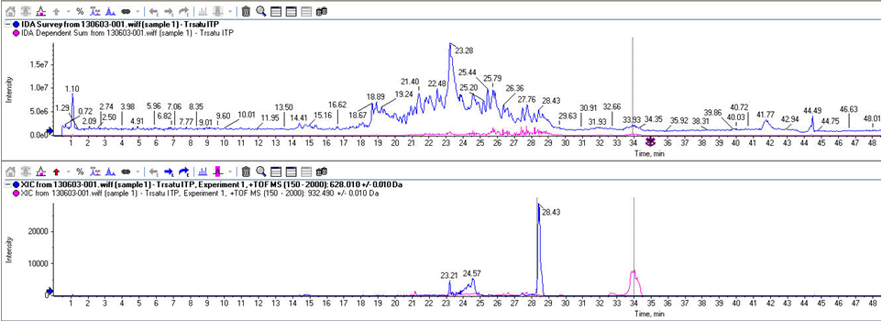
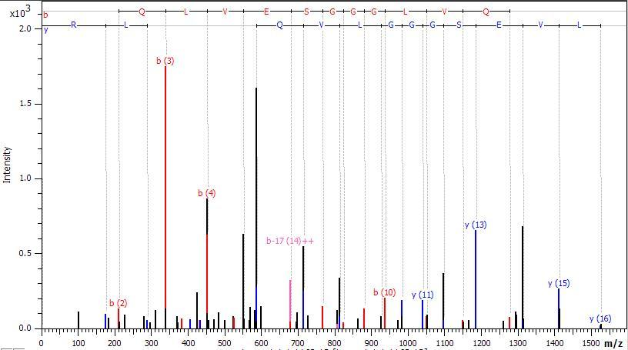
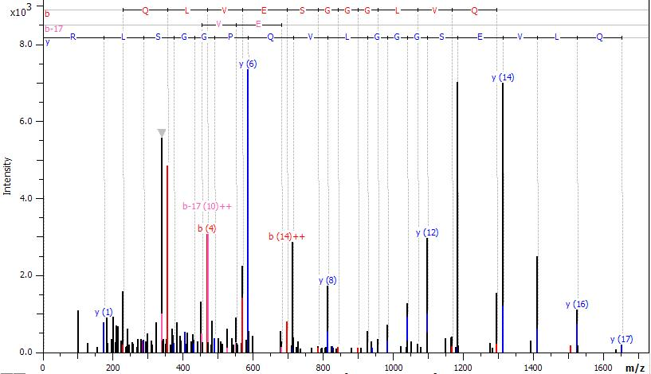
E¹/pE¹ Characterization
EVQLVESGGGLVQPGGSLR
E*VQLVESGGGLVQPGGSLR
100%
50%
0%
100%
50%
0%
b(3)
y(6)
y(13)
y(14)
b(4)
y(14)
b(4)
y(13)
y(7)
y(12)
y(15)
y(15)
y(8)
y(11)
y(16)
b(2)
y(11)
y(16)
y(1)
y(17)

Slide 26
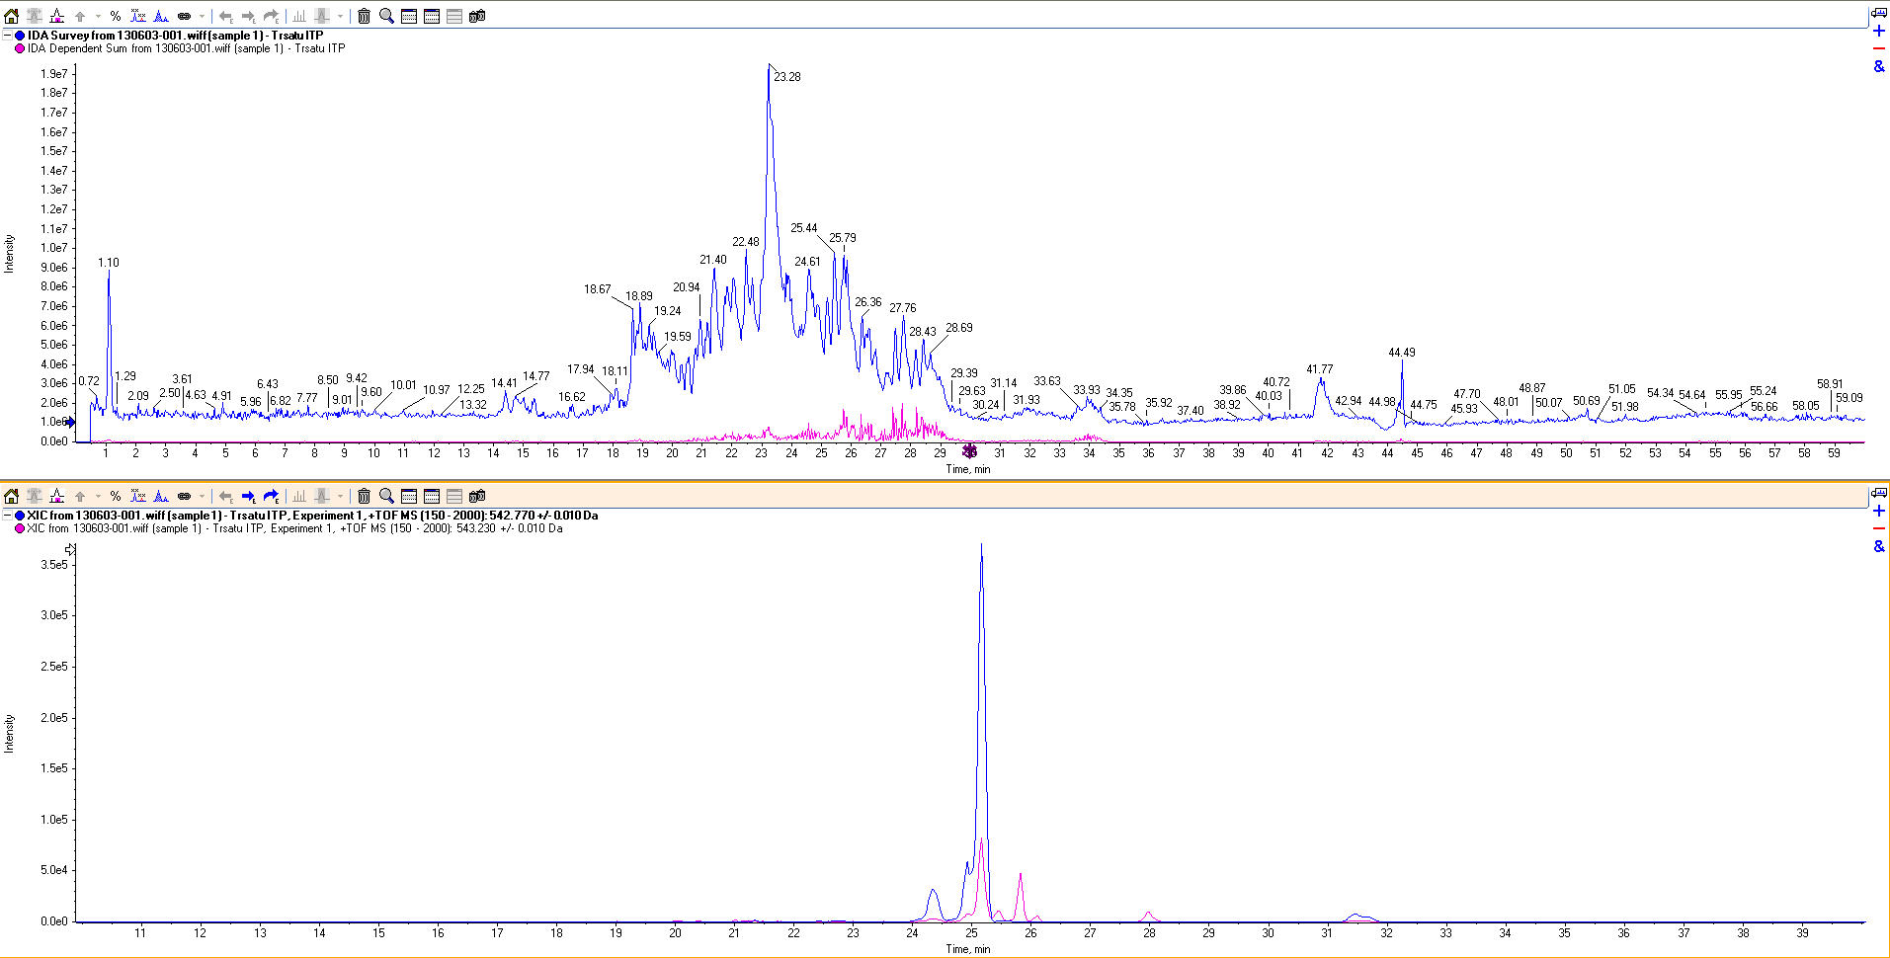
N⁵⁵ Deamidation Characterization
IYPTNGYTR
IYPTN*GYTR
N
N*
y(7)
808.419
y(7)
808.972
100%
50%
0%
100%
50%
0%
y(4)
496.266
y(6)
711.363
y(6)
712.367
y(2)
276.175
y(5)
610.312
y(2)
276.175
y(4)
496.266
y(5)
611.317
y(1)
175.126
y(3)
439.243
b(7)
y(8)
971.476
b(2)
y(3)
439.243
y(8)
972.472
b(2)
b(3)
b(8)
y(1)
175.126
b(3)

Slide 27
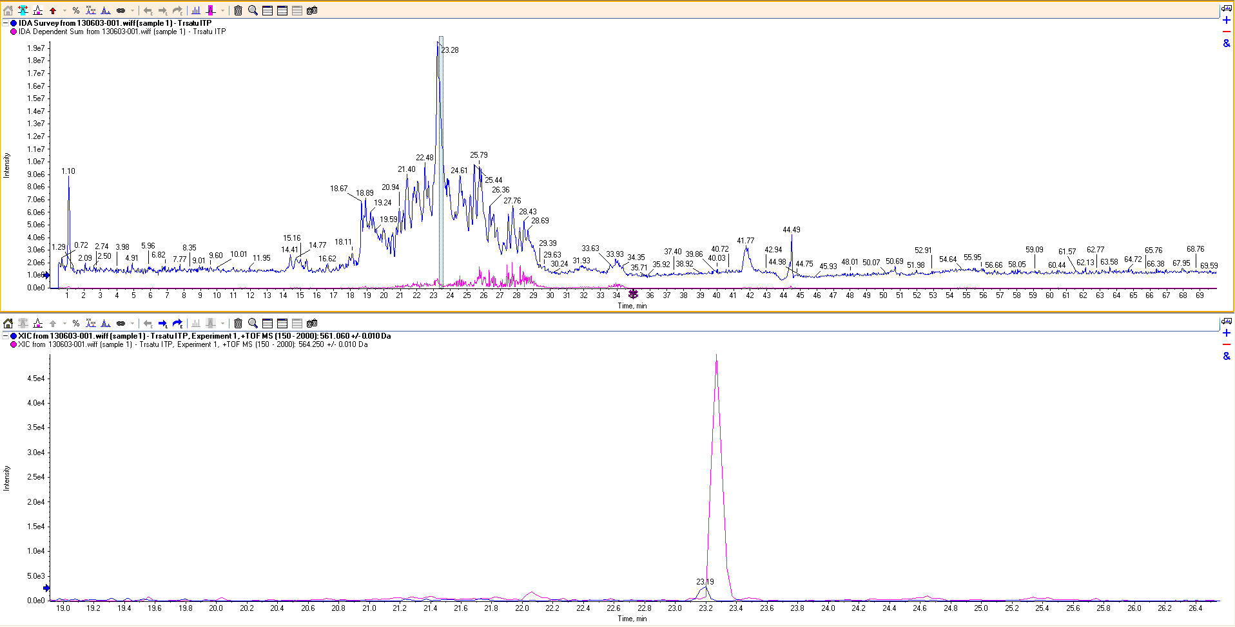
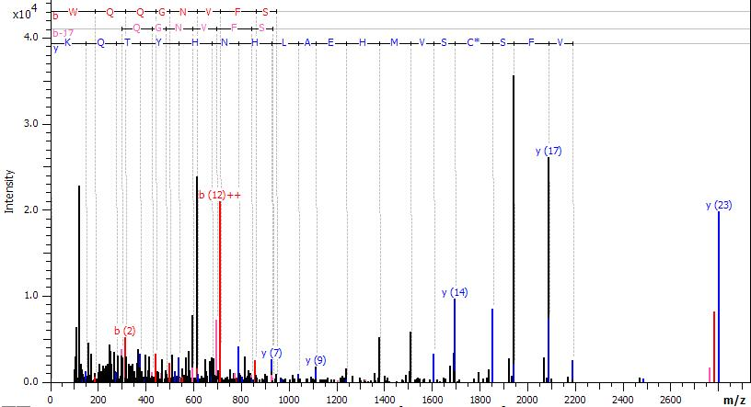
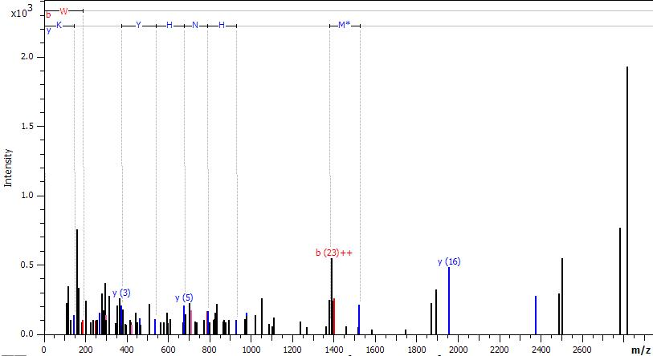
M⁴³¹ Oxydation Characterization
WQQGNVFSCSVM*HEALHNHYTQK
WQQGNVFSCSVMHEALHNHYTQK
100%
50%
0%
M
100%
50%
0%
M*
y(16)
y(17)
y(23)
y(11)
y(15)
y(12)
y(14)
y(4)
y(6)
y(11)
y(16)
y(7)
y(9)
y(13)
y(18)
y(3)
y(5)
y(7)
y(12)

Slide 28

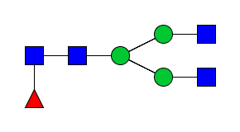
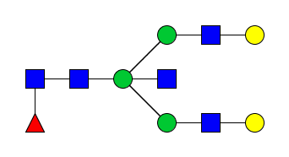
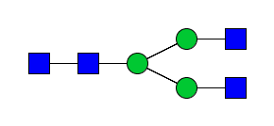
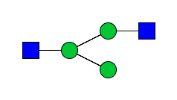

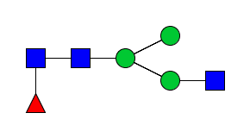

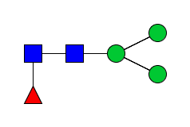
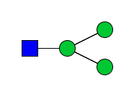
Trastuzumab glycosylation characterization
Structural characterization
Trastuzumab
HT24
HT24
Relative abundance 47.5%
Relative abundance 0.71%
2+
2+
2+
2+
2+
2+
2+
2+
MS/MS spectrum of HT24 – G0F (1217.510, 2+)
MS/MS spectrum of HT24 – H5N4F1 (1581.190, 2+)
CESI-MS/MS method in data dependent analysis acquisition allowed to detect 13 different glycosylations including fragmentation spectra for 9 of them in a single analysis

Slide 29














Glycosylation profiling
Glycosylation distribution
Trastuzumab

Slide 30
Glycosylation profiling
Glycosylation distribution
Trastuzumab
Possibility to detect very low abundant glycosylation

Slide 31
Glycosylation profiling
Glycosylation distribution
Trastuzumab
Potential syalylated form detected (confirmation)
Possibility to detect very low abundant glycosylation

Slide 32
Trastu biosimilar MS/MS peptide mapping
Amino acid sequence characterization (Hz5D4)
EVQLVESGGG LVQPGGSLRL SCAASGFNIK DTYIHWVRQA PGKGLEWVAR
IYPTNGYTRY ADSVKGRFTI SADTSKNTAY LQMNSLRAED TAVYYCSRWG
GDGFYAMDYW GQGTLVTVSS ASTKGPSVFP LAPSSKSTSG GTAALGCLVK
DYFPEPVTVS WNSGALTSGV HTFPAVLQSS GLYSLSSVVT VPSSSLGTQT
YICNVNHKPS NTKVDKKVEP KSCDKTHTCP PCPAPELLGG PSVFLFPPKP
KDTLMISRTP EVTCVVVDVS HEDPEVKFNW YVDGVEVHNA KTKPREEQYN
STYRVVSVLT VLHQDWLNGK EYKCKVSNKA LPAPIEKTIS KAKGQPREPQ
VYTLPPSREE MTKNQVSLTC LVKGFYPSDI AVEWESNGQP ENNYKTTPPV
LDSDGSFFLY SKLTVDKSRW QQGNVFSCSV MHEALHNHYT QKSLSLSPG
DIQMTQSPSS LSASVGDRVT ITCRASQDVN TAVAWYQQKP GKAPKLLIYS
ASFLYSGVPS RFSGSRSGTD FTLTISSLQP EDFATYYCQQ HYTTPPTFGQ
GTKVEIKRTV AAPSVFIFPP SDEQLKSGTA SVVCLLNNFY PREAKVQWKV
DNALQSGNSQ ESVTEQDSKD STYSLSSTLT LSKADYEKHK VYACEVTHQG
LSSPVTKSFN RGEC
Each peptide is correctly identified except K²¹⁷ on the HC
Again complete sequence coverage obtained through tryptic unmodified peptides identification

Slide 33
Trastu biosimilar MS/MS peptide mapping
Trastu biosimilar amino acid substitution characterization
VD
K
R
b
R
V
E
R
K
D
V
y
K
V
MS/MS spectrum of ion 517.302 (1+)
MS/MS spectrum of ion 314.692 (2+)
MS/MS spectra allowed to determine unambiguously Trastu biosimilar amino acid substitution compared to trastuzumab
V D K R²¹⁷ V E P K

Slide 34
mAb Characterization-Conclusion
Single analysis of trastuzumab tryptic digest by CESI-MS/MS
  Complete sequence coverage on both HC and LC
  Characterization of 6 PTMs hot-spots
  Structural characterization of 5 major N-glycosylations
100 fmol digested peptides injected
This methodology is applicable to various mAbs
Use of CE separation mechanism for mAb characterization
  Possibility characterize modified and unmodified peptides
  In some cases, separation of modified peptide (PTMs)

Slide 35


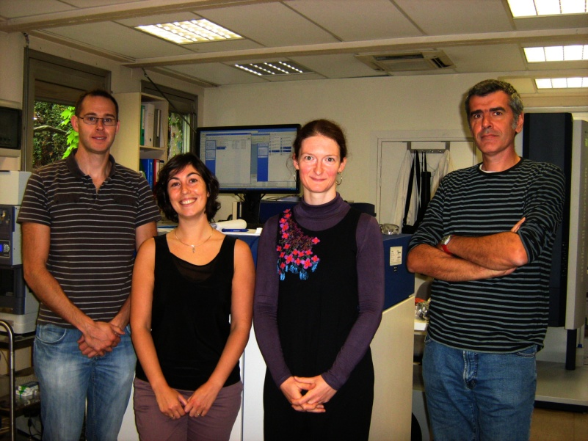
Acknowledgments
Laboratory of Mass Spectrometry of Interactions and System (LSMIS)
Esplanade Proteomic Facility
(Strasbourg)
Emmanuelle Leize-Wagner
Rabah Gahoual
Michael Biacchi
Philippe Hammann
Philippe Wolf
Lauriane Kuhn
Johanna Chicher

Slide 36


Acknowledgments
Gary Impey
Jean-Batiste Vincendet
Centre d’Immunologie Pierre Fabre
Alain Beck
Elsa Wagner-Rousset
Marie-Claire Janin-Bussat
Daniel Ayoub
Olivier Colas
Jean-Marc Busnel
Hans Dewald
Jeff Chapman
Edna Betgovargez
Michel Anselme
Sujet de thèse déposée à l’EDSC Strasbourg

